Slide 1
Week 1 – Introduction and Motivation to Molecular Simulation

Slide 2
Outline
Setting expectations for a new PRG activity (a class)
Syllabus and grading
HW completion
Background and fundamentals
Molecular simulation
Multiscale simulation
Motivation
Why might molecular/multiscale simulation useful?

Slide 3

Molecular simulation (1): Basic concepts
Rule #1: If you understand Physics 114, you can understand molecular simulation!
1. Classical description of the POTENTIAL ENERGY of a molecule:
Ebond = 0.5k*(r-r0)²

Slide 4
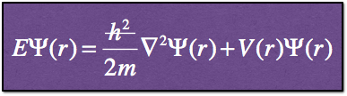
Molecular simulation (1): Basic concepts
Rule #1: If you understand Physics 114, you can understand molecular simulation!
1. Quantum mechanical description of the POTENTIAL ENERGY of a molecule:

Slide 5
Molecular simulation (1): Basic concepts
Rule #1: If you understand Physics 114, you can understand molecular simulation!
2. If you know the potential energy, then you know the FORCES
Fy
Fx
Fz
r={x,y,z}

Slide 6
Molecular simulation (1): Basic concepts
Rule #1: If you understand Physics 114, you can understand molecular simulation!
3. If you integrate the forces, you can obtain the DYNAMICS
^
(twice)
vy ,Δy
vx,Δx
vz,Δz
r={x,y,z}

Slide 7
Molecular simulation (1): Molecular Dynamics
1. Define input molecule(s) and potential energy
2. Calculate forces and velocities and update positions
Completed enough simulation steps?
3. Analyze the “trajectory” of the simulation

Slide 8
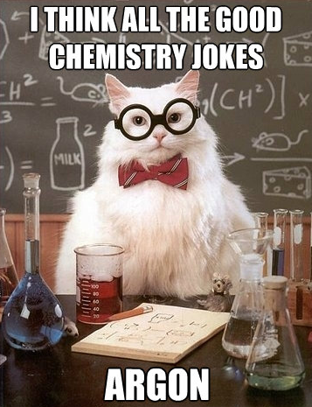
Molecular dynamics isn’t the only way! There’s more than one way to skin a cat!
Key concept: ERGODIC SYSTEM
“The time average = The ensemble average”
MD calculations: time avg
t=0
t=final

Slide 9

Molecular dynamics isn’t the only way! There’s more than one way to skin a cat!
Key concept: ERGODIC SYSTEM
“The time average = The ensemble average”
Monte Carlo calculations
Instead of dynamics we can (randomly) generate many different structures (snapshots) and generate an “ensemble” by weighing them based on their energies

Slide 10
Two types of simulations (MD vs MC) - both give us ensemble averages and macroscopic properties!
MD calculations: time avg
MC calculations: ensemble avg
t=0
t=final
Notes:
common application of liquid or gas simulations is to compute the heat capacity for a simulation. Can be done with both MC or MD calculations. Connection to macroscopic simulations and experiments!

Slide 11
Why do we need multiscale simulations?
For MD calculations of proteins, enzymes, solar cells, plastics we can access around 100 nm for around 1000 ns.
This gives us a very detailed atomic picture!
Many phenomena are relevant at much longer length and time scales...
classical MD simulations are confined to explore local minima
Energy barriers
that are bigger than thermal motions of atoms ( >> kT)
kT(300 K) = .6 kcal/mol
energy
coordinate

Slide 12
Two basic concepts for multiscale modeling
We can reduce the number of degrees of freedom by coarse-grained modeling. “make the beads bigger”
We can increase the rate of of crossing large energy barriers (enhanced sampling) by biasing the system
Fully atomistic protein - ~5,550 d.o.f
“Coarse Grained” protein - ~ 475 d.o.f

Slide 13
Getting real physical insight
Real systems have rugged multidimensional energy landscapes that are a function of local (e.g., active site pKa) and long range (e.g., solvent or ion concentration)
C
A
For simulations to be a powerful tool we must have a way to quantify the important features of these landscapes
B
Figure from: M.S. Shell, P.G. Debenedetti, and A.Z. Panagiotopoulos, Phys. Rev. Lett., 92, 035506 (2004).

Slide 14
What is the point of molecular simulation?
Types of things we can do with MD or MC simulations:
Provide detailed molecular-scale understanding to experiments with lower resolution
[helping to test an existing hypothesis]
Inspire future experiments by performing simulations on new systems
[helping to create a new hypothesis for testing]
[performing exploratory research]

Slide 15
What is the basis for thinking simulations are accurate?

Slide 16
What are the major limitations of molecular simulations?

Slide 17
What are the major benefits of molecular simulation?

Slide 18
Why do we sometimes work on new simulation methods?

Slide 20
THIS POWERPOINT THEME
A UW color palette is built into this theme.
There are three layout styles and three designs in this theme: Purple, Gold and White
The graphic elements, like the bar and the logos are in the Master Sheets. To edit them go to view > master > slide master.

Slide 21
ON-BRAND STATEMENT
FOR GENERAL USE
What defines the students and faculty of the University of Washington? Above all, it’s our belief in possibility and our unshakable optimism. It’s a connection to others, both near and far. It’s a hunger that pushes us to tackle challenges and pursue progress. It’s the conviction that together we can create a world of good. And it’s our determination to Be Boundless. Join the journey at uw.edu.

